Slide 1

AI Use Case Presentation
Notes:
You can customize your presentation by modifying the “key visual” of the Cegid charter.
Other visuals are available in the final slides (appendices), they can simply be copied/pasted.

Slide 2

Welcome & Workshop Objectives
Understand how AI can bring value to EBP products.
Discover real use cases and how they work.
Identify opportunities for experimentation.
This session is collaborative — questions are welcome !!

Slide 3
01.
02.
03.
Context & Mission Objectives
Field Observations & Needs
Concrete AI Use Cases
04.
05.
06.
Understanding the Models
Focus on Applied Models
How AI Projects Work
07.
08.
09.
AI Pipeline & Basic MLOps
Strategic Recommendations
Conclusion
Notes:
Click in the circle to insert a photo.

Slide 4

01
Context & Mission Objectives
Strategic exploration of AI integration in EBP accounting/management software
Objectives:
Propose concrete, relevant AI use cases
Identify data needs for implementation
Define a high-value, limited-scope pilot
Engage product teams, developers, and domain experts

Slide 5

02
Field Observations
Many processes still manual: reconciliation, categorization, entries
Users need intelligent guidance, especially non-experts
High potential in accounting data, but access is technical
Interest in AI chatbot/agent for queries like balances, top clients
Advanced features wanted: forecasting, recommendations, dashboards

Slide 6

03
AI Use Cases Overview
Use Case | Goal | Tech | Data | Benefit
AI Assistant | Query via natural language | LLM + RAG | Accounting DB | Speed, democratization
Cash Flow Forecast | 30/60/90 day projections | LSTM | Transactions, invoices | Planning, visibility
Expense Categorization | Auto-suggest accounts | Embeddings + classifier | Expense details | Time-saving
Reconciliation | Auto-match entries | Fuzzy match + model | Entries (amounts, dates) | Reliability
Smart Dashboards | Dynamic, generated reports | Text-to-Insight + visualization | Accounting data | Instant visibility

Slide 7
Data Preparation Steps:
Convert all dates to standard datetime format
Ensure amounts are numeric and signed (+ for income, – for expenses)
Fill missing values (e.g. assume 0 if no transaction)
Resample by period: weekly / monthly totals
Merge invoice and payment timelines per client
Cash Flow Forecast – Data & Pipeline
Date | Amount (€) | Type | Client | Paid
2024-04-01 | -1,200 | Invoice | A | No
2024-04-05 | -300 | Invoice | B | No
2024-04-10 | +900 | Payment | A | Yes
2024-04-15 | -450 | Invoice | C | No
2024-04-20 | +1,200 | Payment | B | Yes
What users can ask the AI assistant:
“How much cash will I have in 30 days?”
“Which clients are likely to pay late?”
“What’s our projected net cash flow next quarter?”

Slide 8

How the Model Works:
The LSTM is trained on historical patterns like:
When do clients typically pay (after how many days)?
What is the usual monthly outflow?
Do certain months have higher unpaid balances?
Forecast Date | Expected Cash Flow (€)
2024-05-01 | +3,200
2024-05-15 | -1,500
2024-06-01 | +1,800
Then it generates future projections such as:
Why It Matters:
Anticipate cash shortages before they happen
Align expense planning with expected inflow
Improve decision-making for finance and management

Slide 9
Text Cleaning: lowercase, remove accents, punctuation
Tokenization / Embedding: convert text into vector format
Amount Normalization: log scale (for model stability)
Label Encoding: convert account code (e.g. 606000) into integer class
Supplier Matching: unify similar names (“Uber BV” = “Uber”)
Expense Categorization – Preparing the Dataset
Description | Supplier | Amount (€) | Account (label)
Office chairs | IKEA | 540 | 606000 (Furniture & Equipment)
Train ticket to Lyon | SNCF | 122 | 625200 (Travel)
Printer toner | Amazon | 89 | 606300 (Office Supplies)
Uber ride client visit | Uber | 36 | 625200 (Travel)
Google Ads campaign | Google Ireland | 500 | 623400 (Advertising)

Slide 10
What the Model Learns:
“IKEA” and “chairs” often → 606000
“Train”, “SNCF”, “Uber” → 625200
“Google”, “Ads” → 623400
It detects word patterns, supplier behavior, and price ranges to predict the best account code.

Slide 11
Reconciliation – Matching Rules
Data involved:
Bank statement (payments)
Internal ledger entries (invoices, credit notes)
Preparation:
Normalize amounts (absolute values)
Fuzzy match on name fields or amounts
Use date tolerances (± 3 days)
Perfect Match | Not a Match (Amount Too Different)
Bank Transaction: Amount: 850 € Date: 2024-05-10 Description: “Invoice 879 – SARL Beta” Ledger Entry: Amount: 850 € Invoice Date: 2024-05-09 Client Name: “Beta SARL” ✅ Amount = 850 → perfect ✅ Date difference = 1 day ✅ Name similarity ≈ 95% → ✅ Confirmed Match | Bank Transaction: Amount: 498 € Date: 2024-03-20 Description: “Inv 320 – BTP Experts” Ledger Entry: Amount: 520 € Date: 2024-03-20 Client: “BTP Experts SARL” ❌ Amount diff = 22 € → too high ✅ Date exact ✅ Name ~ similar → ❌ Match rejected

Slide 12
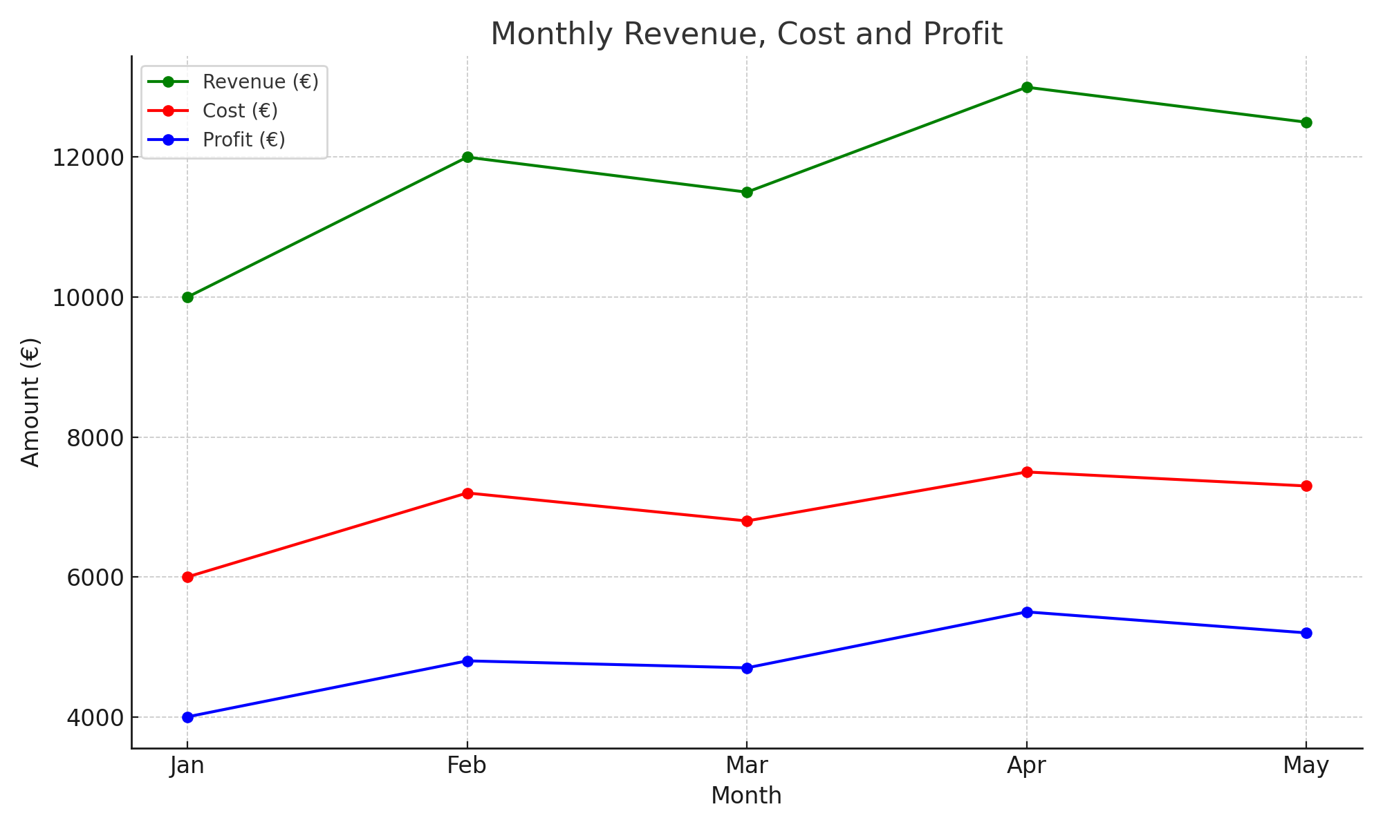
Smart Dashboards – Input and Output
Data inputs:
General ledger (balance sheet)
Period: Monthly, Quarterly
Entity info (Company, Department)
Preparation:
Aggregate per time period
Map accounts to labels (e.g., “Sales”, “Overheads”)
Clean outliers or missing months
Month | Revenue | Cost | Profit
Jan | 10000 | 6000 | 4,000
Feb | 12,000 | 7,200 | 4,800
Mar | 11,500 | 6,800 | 4,700

Slide 13





Enhanced Data Import with AI
A unified space for all data imports within the application
Data interpretation in the application depends on several factors:
The context in which the user is importing the file
The content of the file being imported
No constraints linked to fixed templates
AI recognizes the data without requiring a strict format
AI-assisted data collection
Automatically detects the structure and fields in the file
Adjusts behavior based on user scenario
Time savings
Flexibility
Error reduction
User autonomy

Slide 14
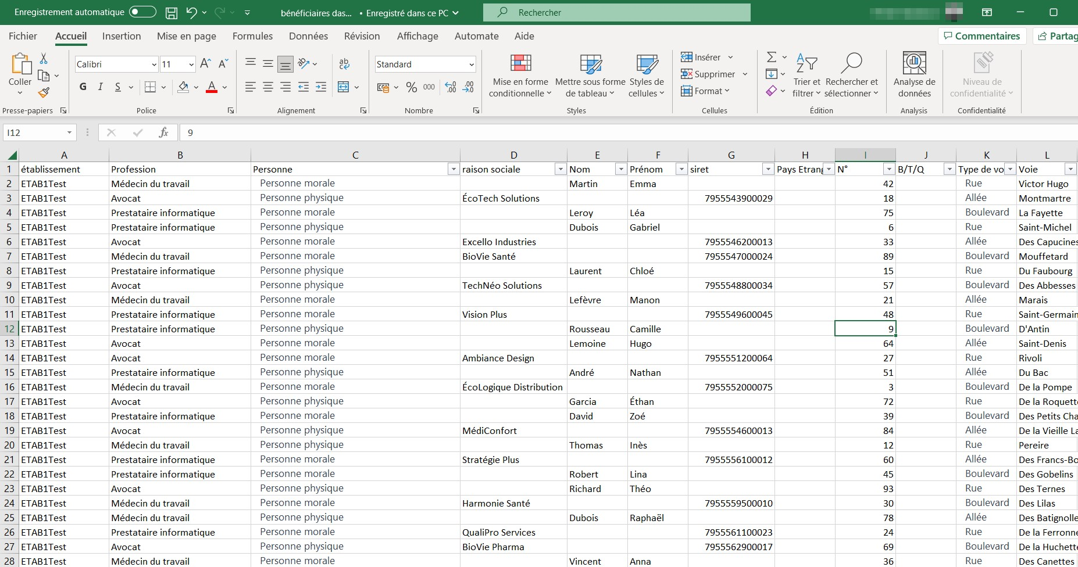



Slide 15

During validation, several benefits of AI were highlighted:
Smart value recognition: Lists of allowed values are not always intuitive (e.g., PPHY for individuals)
Assisted column matching (e.g., for DILITRUST imports): AI helps automatically sort and align columns correctly
Character correction during import: AI can fix encoding issues that would otherwise block EDI integration
Preserve import settings: Ensures that aggregation/overwrite options remain intact during AI-assisted import
Impact preview: Show which documents will be affected by the import based on chosen settings
Multi-state import handling: AI can automatically match documents to the correct states without needing to split or manually group files
Validated Use Cases:
AI-Powered Import Features

Slide 16

Understanding the Models
LSTM:
Fuzzy Matching:
Learns from time patterns — useful for predicting future values.
Like an accountant who knows a client’s payment habits and can predict their delays
Helps identify approximate matches for reconciliation
Embeddings:
RAG / LLM (Retrieval Augmented Generation):
Turn words and entries into vectors the model can understand
Like putting words into a map where similar ones are close (for categorization)
Combines internal documents + AI to answer questions.
Like ChatGPT with access to your private documents
Classification Models:
Trained on labeled examples to suggest categories
Like recognizing an image: here, it’s “what account fits this expense?”
Notes:
You can change the pictograms by copying/pasting another pictogram from the library provided in the final slides in the appendix.

Slide 17
What Makes a Good AI Use Case?
Frequent task
Large volume of data
Clear business value
Acess to data is feasible
Clear output or decision logic

Slide 18
Focus on Applied Models
Notes:
In this slide, you will find two master versions:
- 1 on a dark blue background
- 1 on a light blue background
Click in the circle to insert a photo.

Slide 19

05
Purpose: Simplify interaction via natural language
Examples: "What are my top 10 clients this quarter?", "What is the balance for supplier X?"
Benefits:
Easy access to complex data
Saves time for users
Enables non-experts to use the system effectively
Requirements:
Structured access to accounting databases
Natural Language Processing (NLP) engine
Secure, real-time data retrieval
Conversational AI Assistant

Slide 20
06
Forecasts upcoming cash positions using historical financial data
Incorporates invoices, bank activity, and due dates to produce future projections
Supports short to medium-term planning (30/60/90 days)
Enables early warning for liquidity risks
Built using time series models (LSTM) that learn transaction patterns
Cash Flow Forecasting

Slide 21
07
Intelligent Expense Categorization
Purpose: Automatically suggest accounting categories for expenses
Benefits:
Saves time for accountants
Reduces manual errors
Learns from user corrections
Approach:
Use of pre-trained embeddings for context understanding
Supervised classification model trained on existing labeled data

Slide 22
08
Reconciliation Assistance
Purpose: Facilitate the reconciliation process of bank transactions and invoices
Benefits:
Increases speed and reliability
Minimizes manual matching errors
Helps detect anomalies
Method:
Compare amount, date, third-party name, and other metadata
Use similarity scoring and rule-based filters to suggest reconciliations

Slide 23
09
Purpose: Automatically generate useful reports without prior configuration
Examples:
"Show my profit & loss over the past 6 months"
"Compare sales across regions"
Benefits:
Empower users to analyze without BI knowledge
Immediate business insight
Adaptive to user queries
Requirements:
Structured, up-to-date accounting data
Template-based or AI-generated visualizations
Smart Dashboards

Slide 24



What an AI Project Looks Like
Monitoring / continuous improvement
Deployment & integration
Data collection & exploration
Modeling & validation
Ideation / Cadrage
Notes:
Adjust the position of the points and modify the blocks according to the size of the texts.

Slide 25
Evaluating AI Use Cases – Metrics
Accuracy / precision of model
Time saved per task
Reduction in manual steps
User satisfaction

Slide 26




AI Pipeline & MLOps
Data Ingestion
Cleaning/Preprocessing
Model Training
API Deployment
Monitoring
Notes:
You can change the pictograms by copying/pasting another pictogram from the library provided in the final slides in the appendix.

Slide 27

Strategic Recommendations
Start with high-value, low-risk POC
Focus on explainable, simple models
Invest in internal data literacy
Include domain experts from the start

Slide 28


AI & Compliance: Building Trust and Security by Design
Client Data & GDPR
AI Act & Transparency
Cegid Internal Policy
Best Practices
Consent required to reuse client data
Avoid using personal data in training sets
Prefer anonymized datasets
High-risk systems must be explainable
Document AI decisions for audits
Ensure traceability of predictions
Data usage framework still under review
Collaborate with Security & Legal teams
Anticipate cross-product consistency
Anonymize before training
Version and log every model
Validate outputs before deployment
Notes:
You can change the pictograms by copying/pasting another pictogram from the library provided in the final slides in the appendix.

Slide 29
Conclusion
Notes:
For this slide, you will find two versions in the masters:
- 1 on a dark blue background
- 1 on a light blue background
Click in the circle to insert a photo.

Slide 30

"AI is not the goal, it’s the vehicle to deliver value."
AI in EBP products = strategic opportunity.
Focus on high-impact, low-risk deployments.
Progressive, collaborative integration approach.

